Slide 1
WELCOME TO OUR PRESENTATION ON 8086 Microprocessor’s Instructions
Chowdhury Mobarrat Haider
Sohag saha
Saurav sarker

Slide 2
Outline
We are going to cover in our presentation :
JC
CWD
DIV
IDIV
CBW
AAD

Slide 3
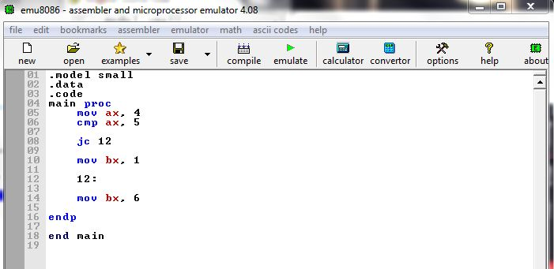
JC
Jump if carry
If carry flag is set to 1 , it will JUMP
So here is the code

Slide 4
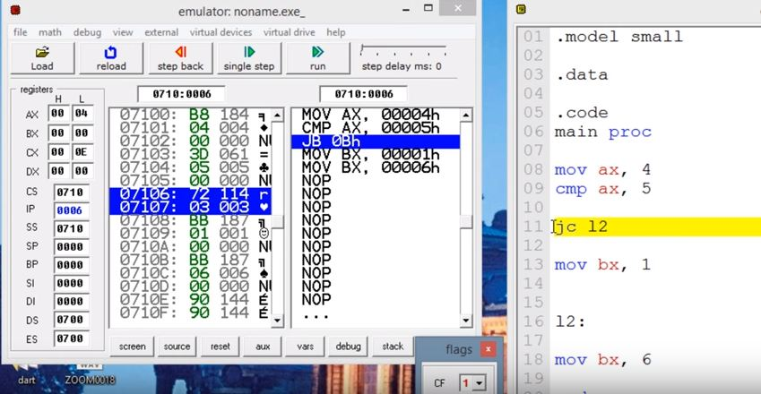
JC

Slide 5
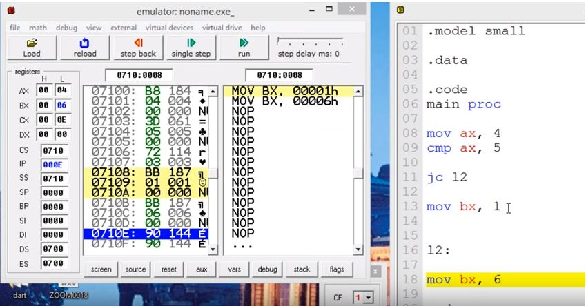
JC

Slide 6
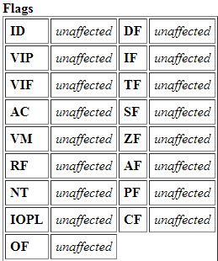
Cwd
Convert word to double word
No operand
The CWD instruction set all the bits in the DX register to the same sign bit of the AX register .
The flags are not modified .
It remains Unchanged .

Slide 7
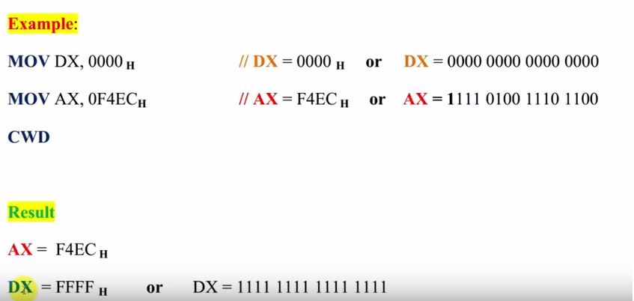
CWD

Slide 8
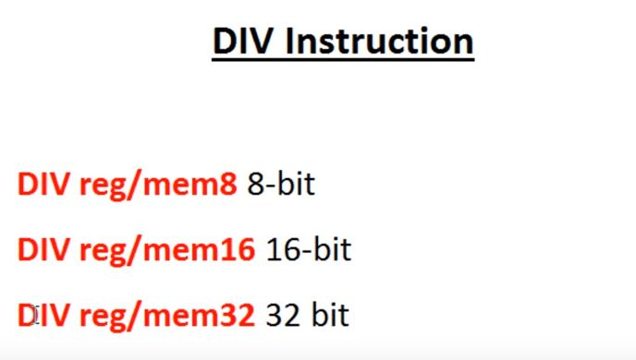
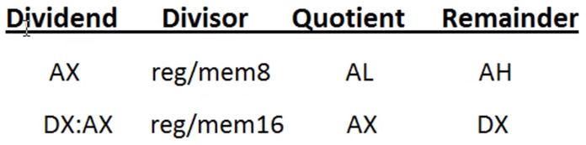
DIV
Unsigned Divide

Slide 9
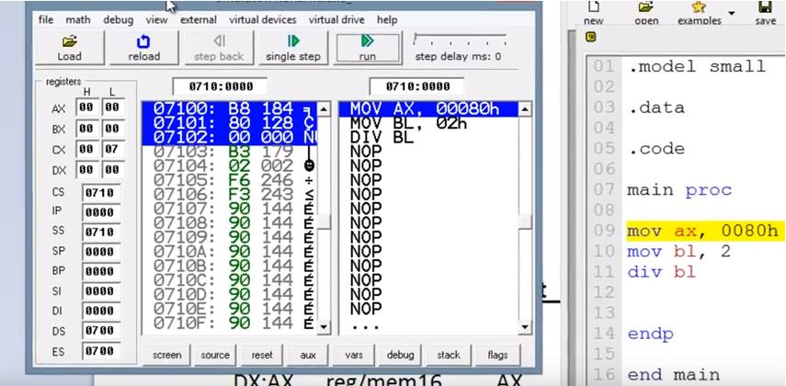
DIV

Slide 10
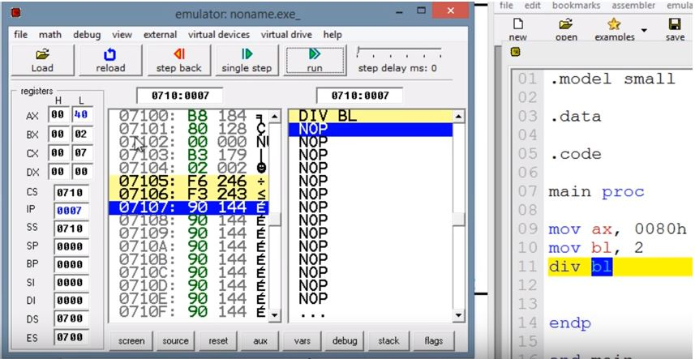
DIV

Slide 11
IDIV
Division for Signed numbers.
Divides (signed) the value in the AL, AX, or EAX register by the source operand and stores the result in the AX, DX:AX, or EDX:EAX registers. The source operand can be a general-purpose register or a memory location. The action of this instruction depends on the operand size.
Flag remain unaffected .

Slide 12
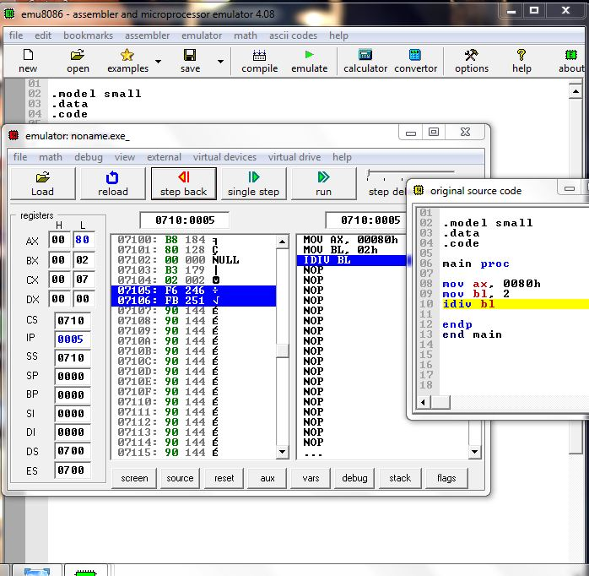
IDIV

Slide 13
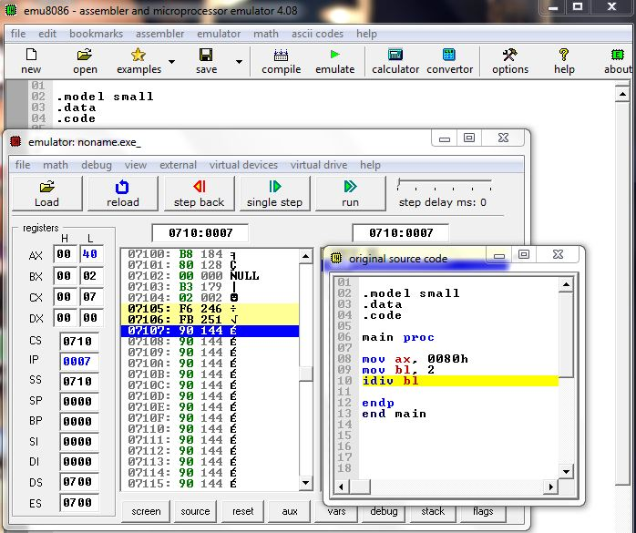
IDIV

Slide 14
CBW
Convert Byte to word
This instruction copies the sign of a byte in AL to all the bits in AH .
AH is then is said to be the sign extension of AL.
Flag are unchanged & not modified.

Slide 15
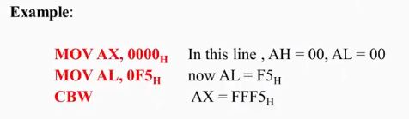
cbw
In the example , F5h is the equivalent to 11110101B , this means the sign bit 1.
After the CBW, the sign bit (1 in this case) will be extended to AX register.

Slide 16
AAD
ASCII Adjust AX Before Division.
This instruction converts two unpacked BCD digits in AH and AL to the equivalent binary number in AL.
This adjustment must be made before dividing 2 unpacked BCD digits in AX by an unpacked BCD byte. In the instruction sequence, this instruction appears Before DIV instruction.
Flags Affected
The SF, ZF, and PF flags are set according to the resulting binary value in the AL register; the OF, AF, and CF flags are undefined.

Slide 17
AAD
EXAMPLE :
AX 05 08 AAD result in AL 00 3A ,since 58D = 3AH in AL
The result of AAD execution will give the hexadecimal number 3A in AL and 00 in AH. Where 3A is the hexadecimal Equivalent of 58 (decimal).

Slide 18
Thank you
Any Question ????

